Slide 1

HOW TO BUILD
A CHATBOT
Hands-On Workshop
Author: Martin Kovacs

Slide 2
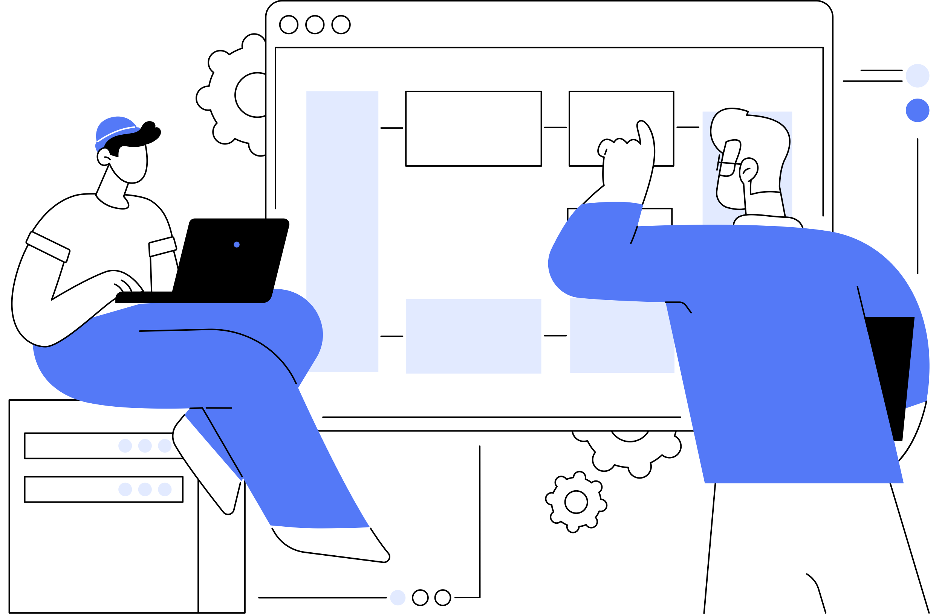
Welcome
Martin Kovacs (M.Sc.)
AI Research Engineer @ Festo
Lecturer Machine Learning @ HS Esslingen
Research Field:
Generative AI
LLM Agents
LLM Multi Agent Systems

Slide 3
Introduction
Overview of the day’s agenda and workshop goals
Introduction to workshop hardware NVIDIA Jetson Orin Nano
Setting up the development environment

Slide 4
Workshop Agenda
Session 1
Session 2
Session 3
Session 4
Session 5
Theory:
Introduction to Large Language Models (LLMs)
Practise:
Deploy and use LLMs
Theory:
Introduction to LangChain
Practise:
Use LangChain with LLMs
Theory:
Introduction to Retrieval-Augmented Generation
Practise:
Deploy vector database, data integration & search
Theory:
Introduction to RAG Chains in LangChain
Practise:
Implement a Q/A-RAG Chain
Theory:
How to build a RAG-Chatbot
Practise:
Implement a RAG-Chatbot App
-> STEP BY STEP TO YOUR OWN CHATBOT

Slide 5
Workshop Timeline
Time | Topic | Duration
09:00 AM | Start of Workshop | -
09:00 AM - 09:15 AM | Welcome and Introduction | 15 min
09:15 AM - 09:30 AM | Session 1: Introduction to LLMs - Theory | 15 min
09:30 AM - 10:30 AM | Session 1: Introduction to LLMs - Practical | 60 min
10:30 AM - 10:45 AM | Session 2: Introduction to LangChain - Theory | 15 min
10:45 AM - 11:45 AM | Session 2: Introduction to LangChain - Practical | 60 min
11:45 AM - 12:00 PM | Session 3: Retrieval-Augmented Generation (RAG) - Theory | 15 min
12:00 PM - 12:30 PM | Lunch Break | 30 min
12:30 PM - 1:30 PM | Session 3: Retrieval-Augmented Generation (RAG) - Practical | 60 min
1:30 PM - 1:45 PM | Session 4: Building a RAG-Chain - Theory | 15 min
1:45 PM - 2:45 PM | Session 4: Building a RAG-Chain - Practical | 60 min
2:45 PM - 3:00 PM | Session 5: Building the Chat Application - Theory | 15 min
3:00 PM - 4:00 PM | Session 5: Building the Chat Application - Practical | 60 min

Slide 6
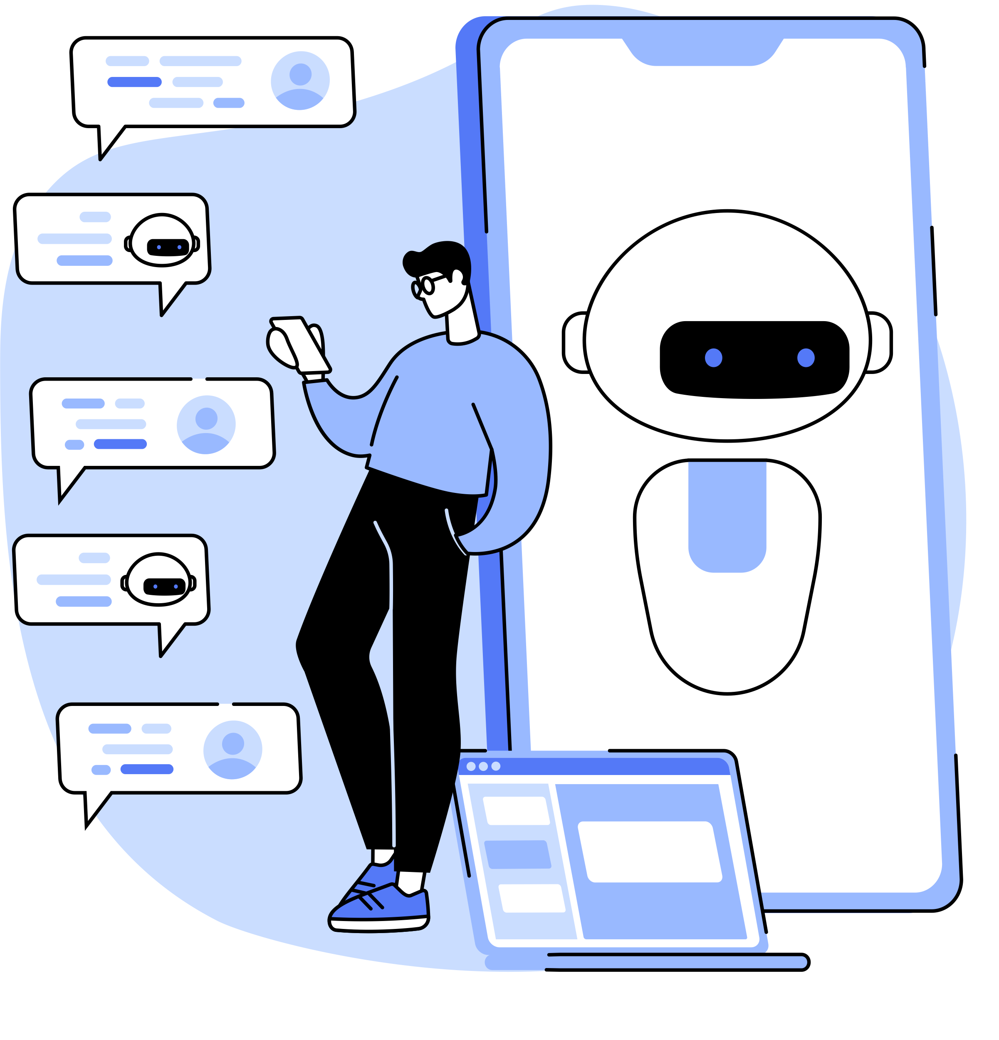

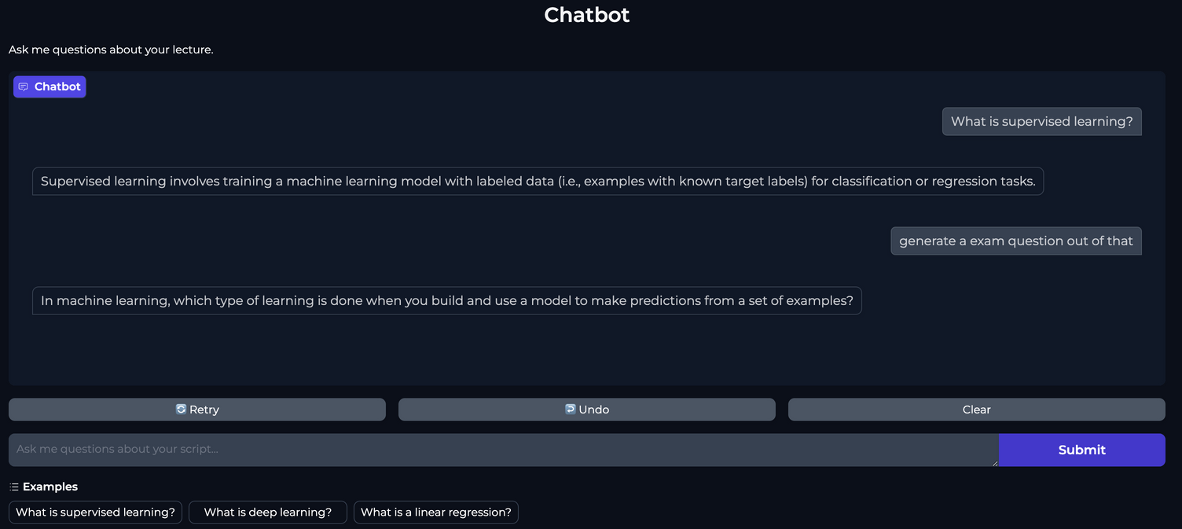
Workshop goal
Personalized Learning Assistant:
Create a chatbot that acts as a learning tutor.
Interactive Study Tool:
Use your own lecture script
Ask questions about the content

Slide 7
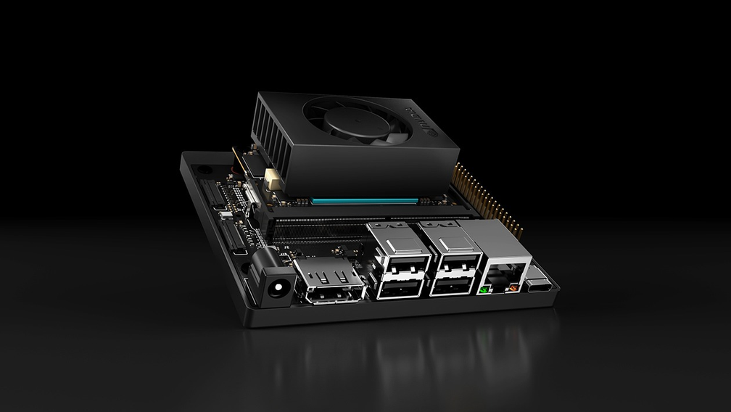
NVIDIA Jetson Orin Nano
Edge AI platform
ARM-based CPU with NVIDIA Ampere GPU
Supports NVIDIA JetPack SDK and AI frameworks
Ideal for on-device AI applications and models

Slide 8
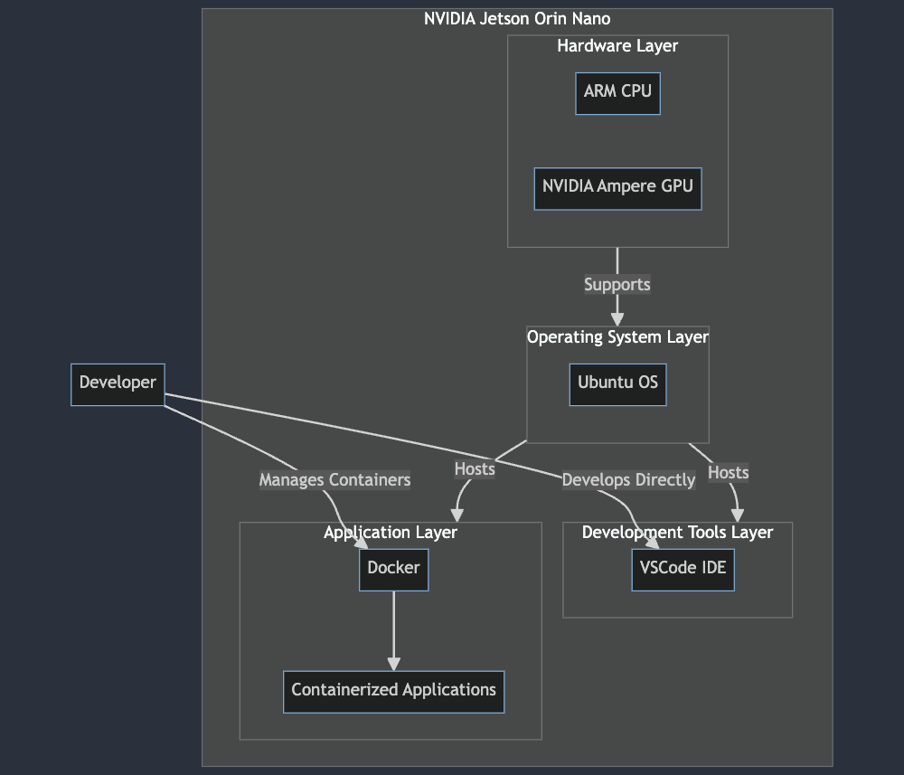
Development Env
Hardware Layer:
ARM CPU and NVIDIA Ampere GPU handle computing.
Operating System Layer:
Ubuntu OS provides the base environment.
Development Tools Layer:
VSCode IDE is used for direct development on the device.
Application Layer:
Docker runs containerized AI applications.
Developer Interaction:
Developers code and manage containers directly on the Orin Nano.

Slide 9
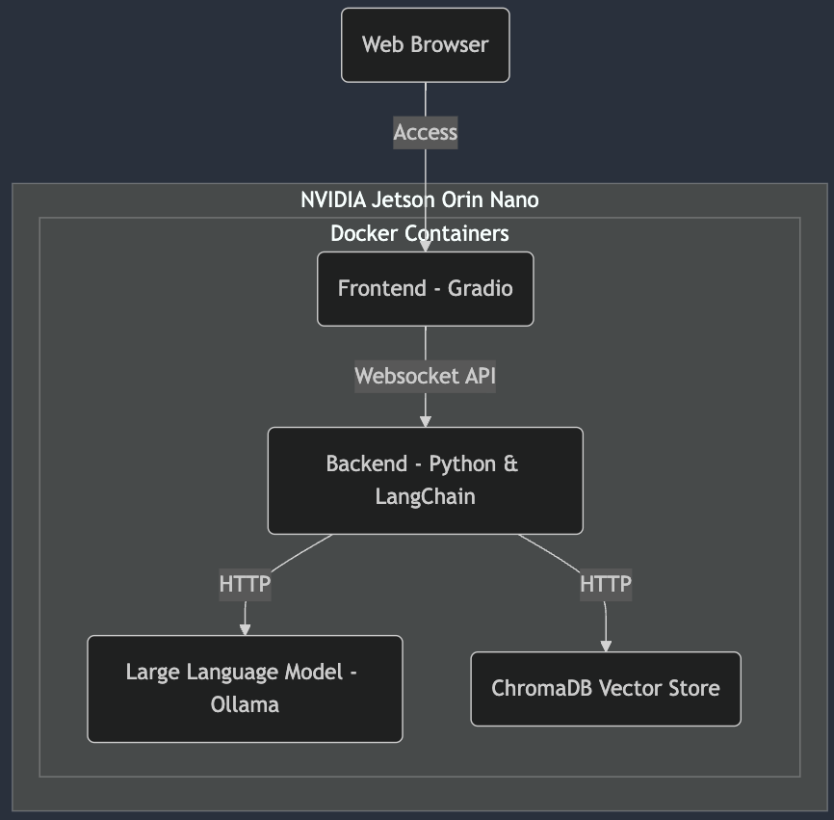
Goal architecture
Frontend:
Web app built with Gradio, accessible via browser.
Backend:
Python-based with FastAPI and LangChain.
LLM Serving:
Ollama for managing large language models.
Knowledge Storage:
Vector database for knowledge management.
Deployment:
Docker containers for application deployment.

Slide 10

Startup dev env
Power On:
Start NVIDIA Jetson Orin device.
Login:
Authenticate with user credentials.
Launch VSCode:
Open the development environment.
Open Repository:
Access template project.
Verify Docker:
Ensure Docker is running
Follow instructions > “startup_dev_env.md”

Slide 11
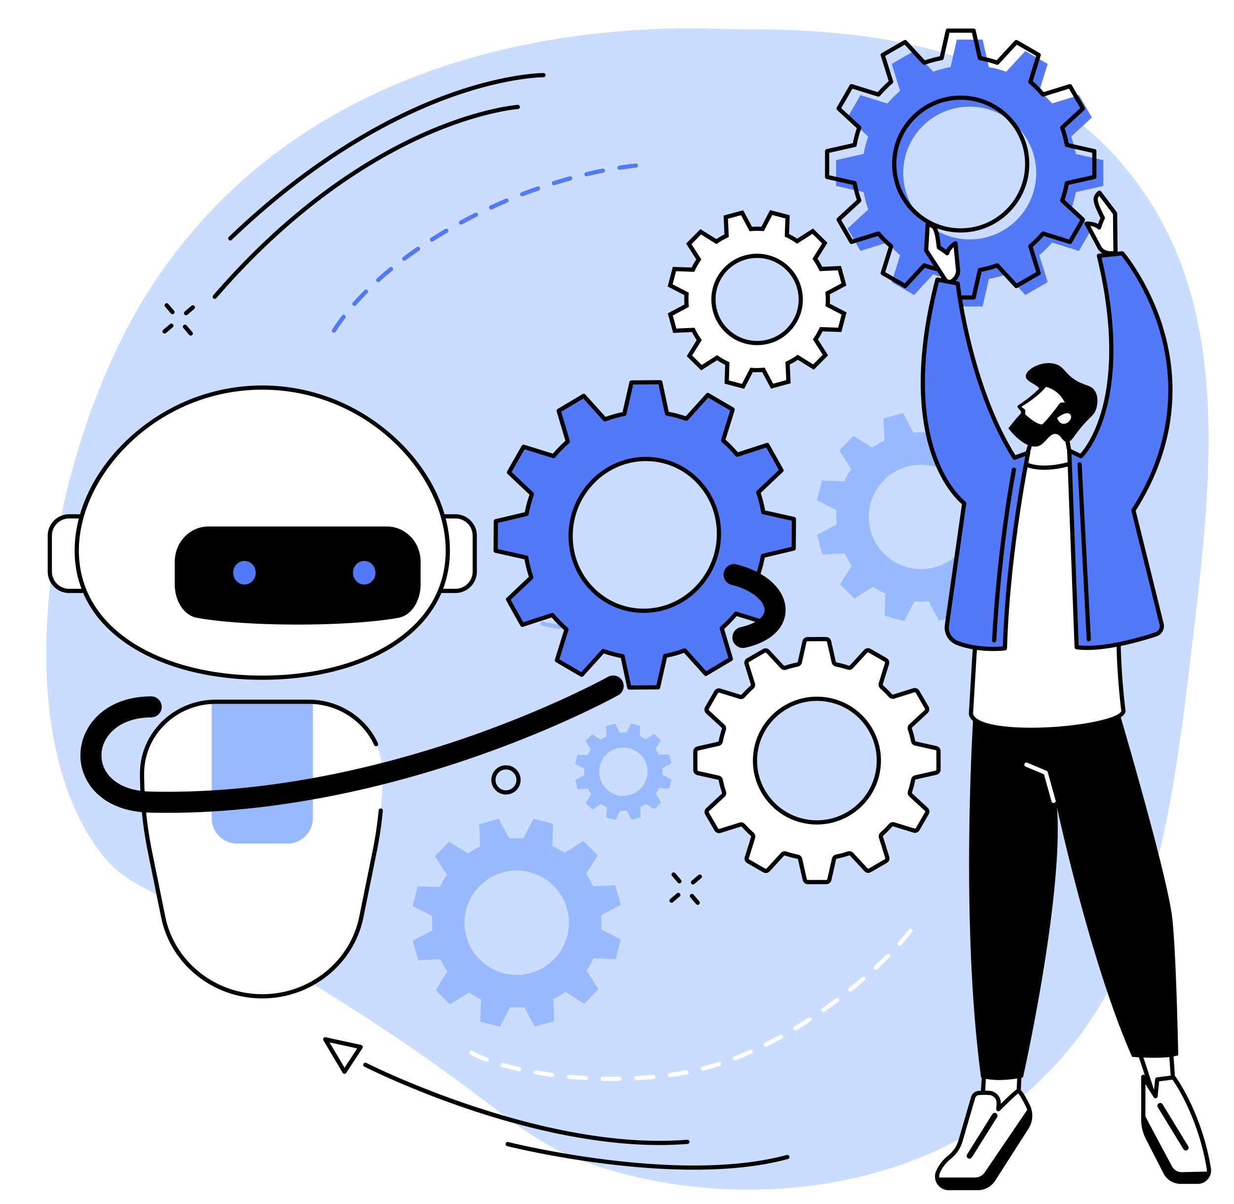
IT’S YOUR TURN

